Slide 1
Menopause and Skin Issues
Suzie McCullagh OHNA

Slide 2

Learning Objectives
• Understand how menopause affects the skin
• Recognise common skin conditions during menopause
• Identify workplace factors that may worsen symptoms
• Understand occupational health support strategies

Slide 3
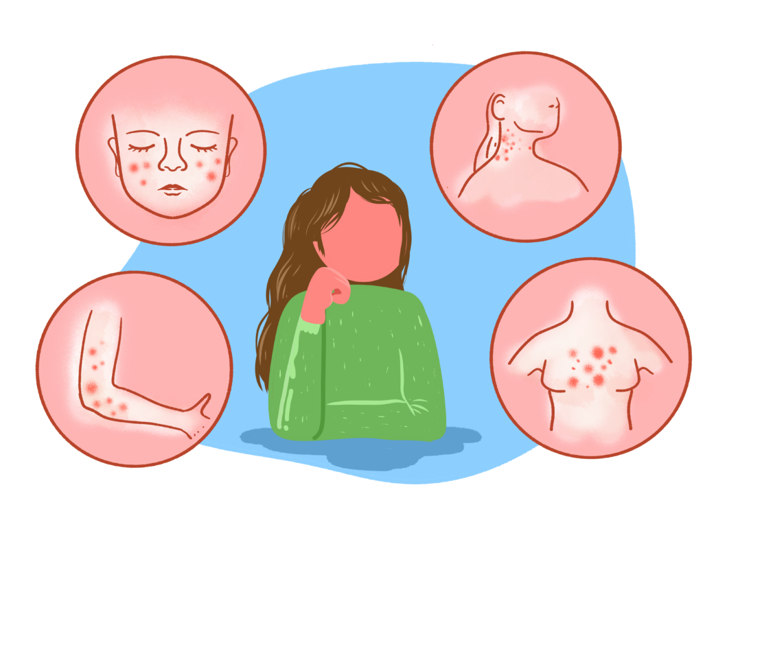
What is Menopause?
• Natural biological stage marking end of menstruation
• Usually occurs between ages 45–55
• Caused by decline in oestrogen and progesterone
• Can affect multiple body systems including the skin

Slide 4
What Skin Changes Occur
• Reduced oestrogen leads to loss of collagen
• Skin becomes thinner and less elastic and more sensitive (and irritable).
• Reduced hydration and oil production
• Slower wound healing
Skin tone and dark marks, as oestrogen regulates melanocyte activity

Slide 5
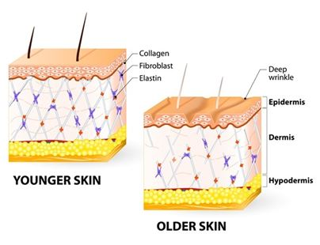

Slide 6
Common Skin Issues in Menopause
• Dry or itchy skin
• Increased sensitivity • Acne or rosacea flare ups
• Skin thinning and bruising
• Increased sweating and hot flush related irritation
Increased susceptibility to external irritants.

Slide 7
Workplace Factors That Can Worsen Symptoms
• warm working environments
Poor ventilation
• PPE and occlusive clothing
• Frequent handwashing or sanitizer use
• Exposure to irritants or chemicals
• Stress and fatigue

Slide 8
Impact on Work
• Discomfort and distraction
• Sleep disturbance from itching or night sweats
• Reduced confidence
• Increased sickness absence if unmanaged

Slide 9
Occupational Health Assessment
• Review symptoms and medical history
• Identify workplace triggers
• Consider skin self referral or GP referral
• Dermol

Slide 10
Skin Management Strategies
• Emollients and protective creams
• Avoiding harsh soaps
• Optimised PPE selection
• Cooling strategies during hot flushes
• Hydration and nutrition
HRT gel can dry skin-alternate sites
Wash hands after applying gel, use gloves or the lid of the tube.

Slide 11
Workplace Adjustments
• Access to temperature control or ventilation
• Flexible uniform or breathable fabrics
• Skin friendly soaps and moisturisers. Dermol (pharmacy)
• Breaks to manage symptoms
• Education and menopause awareness

Slide 12
Support and Advice
• Encourage consultation with GP
• Discuss treatments (e.g. emollients, HRT)
• Encourage supportive management culture

Slide 13
When to Refer
• Persistent or worsening dermatitis
• Suspected occupational skin disease (self refer)
• Severe psychological impact
• employee/management support

Slide 14
Key Takeaways
• Menopause can significantly affect skin health
• Workplace factors may worsen symptoms
• Occupational health plays a key role in assessment and support
• Early recognition and adjustments improve wellbeing and productivity

