Slide 1
CBT for menopause symptoms
Dr Laura Thompson
Consultant Clinical Psychologist
Staff Wellbeing

Slide 2
Aims/hopes

Slide 3
Definitions
Menopause -Absence of menstrual cycle for 12 consecutive months and subsequent decline of female sex hormones including oestrogen, progesterone +/-testosterone
Average age of onset is 47 years. Average duration is 4 years
Well-being can be understood as how people feel and how they function, both on a personal, social, financial and sexual level, and how one evaluates life as a whole

Slide 4
What the research says
1 in 100 women reach the menopause before the age of 40
1 in 1000 women under 30 experience menopausal symptoms
45% of women say they feel their menopause symptoms have had a negative impact on QoL
Symptoms experienced as problematic by 20-25% of women
Main symptoms are hot flushes and night sweats (HF/NS), which affect 60-70% of women, and these can be induced by breast cancer treatments
Menopause symptoms does not work on a ‘one size fits all’ basis and all women will experience their symptoms differently, with some women not experiencing any at all

Slide 5
Understanding and addressing menopause symptoms
Biological
Social
Psychological
Notes:
Understanding within the context of biopsychosocial model

Slide 6
NICE guidelines for treating menopause symptoms
Hormone replacement therapy (HRT) as a ‘first line’ treatment for vasomotor symptoms such as hot flushes and night sweats (HF/NS).
Research evidence shows that CBT can help:
Reduce frequency of hot flushes and night sweats
Improve coping with HFNS (reduce HFNS problem rating)
Improve sleep, depression and anxiety symptoms
It also recommends menopause-specific cognitive behavioural therapy (CBT) should be considered for:
women over 40 as an option for menopausal symptoms in addition to HRT
or people for whom HRT is not advised
or for those who prefer not to take HRT.

Slide 7
The psychological impact of HF/NS
General stress, anxiety and depressed mood are associated with reduced coping with HF/NS
50% of subjective hot flushes are associated with a trigger e.g. stress, temperature changes, hot drinks, alcohol
Negative thoughts and beliefs about menopause and hot flushes associated with increased distress about symptoms:
Shame or social embarrassment – “I’m over the hill”; “I look terrible”; “Everyone is looking at me”
Feeling out of control - “Not again…! This is out of control.. My body is letting me down”
Catastrophic thinking - “This is awful and it will never get any better”
Occurs at a time when there may be other life changes (e.g. parents’ ill health, bereavement, adolescent children, children leaving home, work demands).
Notes:
Psychology of symptoms – triggers and impact

Slide 8
What’s important/ What works
New ways of coping and regaining control
From control to acceptance
Making sense of symptoms and changes
No one size fits all
Knowledge and awareness
Empowered and informed
Socio-cultural context and support
Challenging taboo
Mindfulness and paying attention
Connecting and engaging with others
Independent learning
Helps to challenge beliefs and perceptions

Slide 9
CBT for menopause symptoms
Increased knowledge and awareness
Managing stress and general wellbeing
Improving sleep
Addressing thought patterns
Behavioral strategies

Slide 10
The CBT model

Slide 11
Understanding hot flushes
No symptoms
Thermo-neutral zone
Core body temperature
Hot flushes
Symptoms
Narrowed thermo-neutral zone
Shivering
Lower oestrogen, stress
Hot flush thresholds with and without symptoms
Notes:
Everybody has a thermo-neutral zone (hot flush threshold) which is the range of temperatures that your body can experience without having to actively regulate. Therefore temperature can go up or down and your body adapts to these without having to sweat to cool you down, or shiver to warm you up. A woman with no menopausal symptoms would be shown in the first part of the diagram.
However because hormones and body temperature control are linked, the hot flush threshold becomes narrower following the menopause and following types of breast cancer treatment due to changes in oestrogen levels.
Therefore there are a smaller range of temperature changes your body can experience before regulation (sweating and /or shivering) start. The same changes that your body could tolerate before may now trigger hot flushes and night sweats. This is shown in the second part of the diagram.
Stress also effects the hot flush threshold so the more stressed you are, the more likely this zone will be smaller. Previous research suggests that being stressed does however raise frequency and intensity of hot flushes overall.
The body will naturally adjust to these changes over time and eventually the hot flushes /night sweats stop. This is a gradual process.

Slide 12
Understanding thinking patterns

Slide 13
Thoughts, feelings, behaviours and physical reactions to hot flushes
Behaviour
Avoid situations, hide face, use fan,
Open windows, stop what I’m doing until it passes
Physical Symptoms
Heat, sweaty, palpitations, red face,
Breathless, nausea, tingling
Feelings
Embarrassed, ashamed, anxious,
angry, trapped, frustrated,
out of control
Thoughts
People will think something is wrong
My body is letting me down
Not another one!
I can’t cope!
Notes:
Group discussion and brainstorm to examine validity of thoughts:
Today we are going look closely at these thoughts, and examine their helpfulness in the event of a hot flush, with a view to developing a calmer response. You will still have the hot flush but will take out all the negative emotions that accompany them.
What we are going to look at is how we can test out these thoughts and see if they are 100% true using a series of questions.
Would a friend see this differently? Would he/ she agree wholeheartedly with this thought or would they have a different view on this?
If a friend had this thought, would you agree with the thought 100%? If not, what would you say to your friend? Especially if self critical- highlight difference in response to self and others
Are there times in the past where you can see that this thought has not been true (e.g. have you coped?)
If it is about what others may be thinking, what evidence do you have that they think in that way, might they be thinking something else? Are you able to mind read? What would you think if someone else had a hot flush?
What are the advantages and disadvantages of thinking in this way?
What is impact on feelings and behaviour following on from these answers?
Now that you have ran through these, can you substitute a more helpful thought for the anxious thoughts?

Slide 14
Enhancing sense of control (p161)
Cognitive strategies:
Develop an attitude of calm acceptance
Opening up – self compassion
Checking expectations
Understanding hot fluses
Identify catastrophising thoughts/ words and deal with each flush one at a time
Shifting attention/focus
Behavioural strategies:
Use paced breathing at the onset of a flush (switch your attention to your breathing rather than the discomfort)
Relaxation: Deep breath in, relax shoulders, supportive self statement and paced breathing
Managing stress
Identifying and eliminating triggers
Maintaining activities –activity monitoring

Slide 15
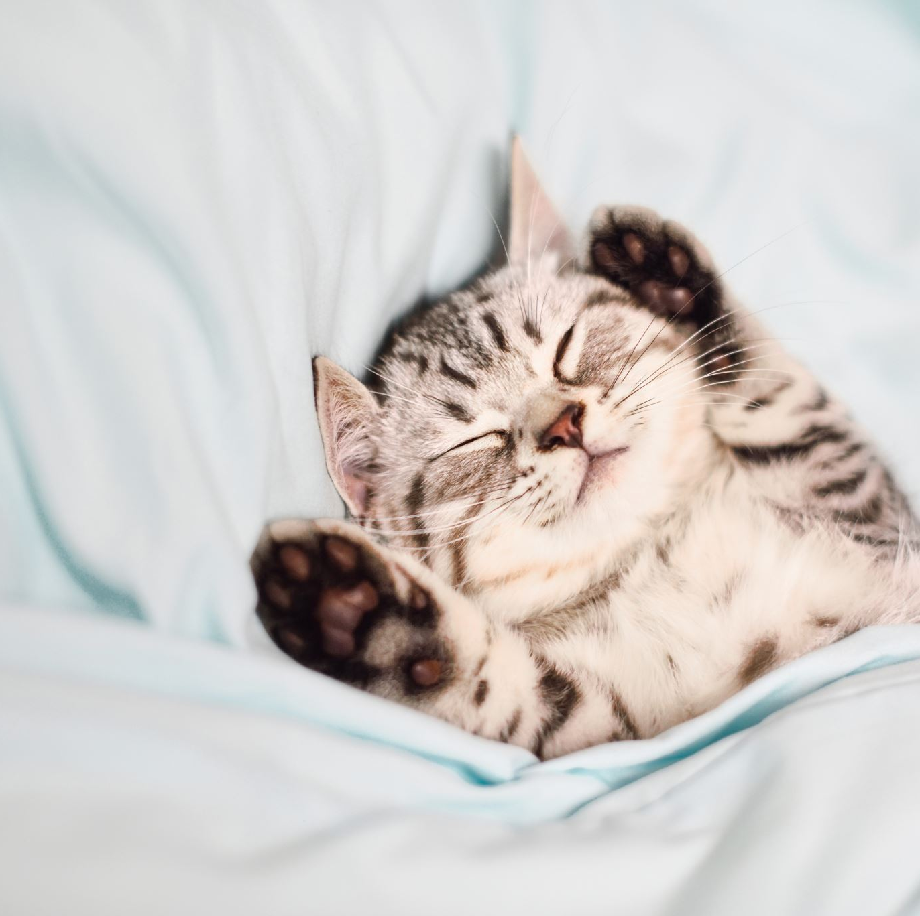
Sleep (NS) Sleep psychoeducation and hygiene Managing worries about sleep Developing better sleep habits Impact of lifestyle factor on sleep e.g. diet, exercise, drinking Wind down routine Sleep scheduling Managing daytime tiredness

Slide 16
A cognitive behavioural model of menopausal symptoms
Stress, anxiety and life-style triggers
Emotional reactions: distress, embarrassment, irritation
Physiological:
HF threshold, frequency
Perception
of HF/NS:
Frequency & problem rating
Behavioural : avoidance, coping strategies
Cognitive: negative beliefs about HF/NS, menopause
Notes:
This is a holistic model which shows how our experience hot flushes and night sweats (box at the centre) are influenced by: bodily changes in oestrogen and the hot flush threshold; Stress and lifestyle; and Thoughts, feelings, and behaviours
Physiological factors: In terms of the physiological factors, we have the reduced TNZ, caused by declining oestrogen. However, the TNZ is also influenced by stress, which is why this links to the stress/anxiety/lifestyle box.
Cognitive factors: We also know that the way we think, including our beliefs (for example about the menopause, or about how life should be after recovering from breast cancer treatment, etc.) can also influence our experience.
Behavioural factors: In addition to our thoughts, our behaviour can also influence how we experience our hot flushes. Some behaviours are helpful and some are less helpful e.g. a person who avoids meetings due to fears about hot flushes, but this then increases anxiety about that situation.
DISTRIBUTE HANDOUT 3 (CBT MODEL OF MS)
Plan for the sessions
This week we’ll look at the physiological side and at what we can do to manage that, using stress management techniques as well as introducing relaxation techniques. Next week we’ll look at the cognitive and behavioural aspects of hot flushes. In week 3 we will concentrate on sleep, including coping with night sweats and improving overall sleep quality. All of this is underpinned by relaxation and paced breathing which together serve to “deactivate the system”. In the final session we’ll pull it all together and draw up a maintenance plan.

Slide 17
Mindfulness and Relaxation Exercises
It is a good idea to build mindfulness and/or relaxation exercises into your daily routine – think proactive, not reactive – but they are also helpful when you’re feeling tense or anxious.
Examples;
Progressive muscle relaxation
Safe place imagery

Slide 18
What can we do to support ourselves and colleagues?
Talk about it! Learn more about it and raise awareness with others
Be sensitive to others – some may feel comfortable talking about this, other won’t – be respectful
Ensure colleagues have control over their working environment wherever possible to include the temperature and flexible breaks
Ensure toilet and sanitary access is good at all times
Provide access to fans and good ventilation
Encourage all staff to take exercise during breaks to access fresh air and sunlight
Uniforms – where these are required are they made of natural fibres and sufficiently loose fitting?
Workstation design – avoid restricted positions
Be mindful of workplace temperatures – a woman’s body temperature can rise by up to 5 degrees during a hot flush
Seek support

Slide 19
Take home points
Normal, natural and reasonable
Empowerment in naturally increasing “feel good” hormones
Importance of adjustment
Research isn't all negative
Support is available

Slide 20
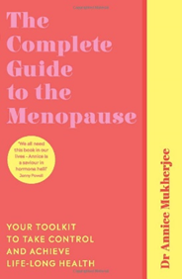
CBT for menopausal symptoms - books
Living Well Through The Menopause:
An evidence-based cognitive behavioural guide. Paperback by Myra Hunter and Melanie Smith
The Complete Guide to the Menopause: Your Toolkit to Take Control and Achieve Life-Long Health. Paperback by Annice Mukherjee

Slide 22
Other helpful sources of information…
Learn more about healthy eating for women
https://www.bbcgoodfood.com/howto/guide/balanced-diet-women
https://www.nhs.uk/live-well/eat-well/eight-tips-for-healthy-eating/
Mindfulness techniques in the workplace:
https://www.personneltoday.com/hr/how-practising-mindfulness-in-the-workplace-can-boost-productivity/
https://www.mindful.org/10-ways-mindful-work/
More info on Menopause, PMS, PMDD and Endometriosis
PMS: https://www.nhs.uk/conditions/pre-menstrual-syndrome/
PMDD: https://www.mind.org.uk/information-support/types-of-mental-health-problems/premenstrual-dysphoric-disorder-pmdd/#.W5d64uSWy71
Endometriosis UK: https://www.endometriosis-uk.org/
Endometriosis Helpline: 0808 808 2227

Slide 23
Thank you
laura.thompson@belfasttrust.hscni.net

